Slide 1
Computer arithmetic
Unit 7

Slide 2
There are 3 ways of representing negative fixed point binary numbers. They are
1. Signed Magnitude representation.
2. Signed one’s Complement representation
3. Signed two’s Complement representation
Most computers use the Signed two’s Complement representation when performing operation on integers.
Consider the magnitude of any two numbers A and B and the eight different operation are listed below depending on the sign of the number

Slide 3
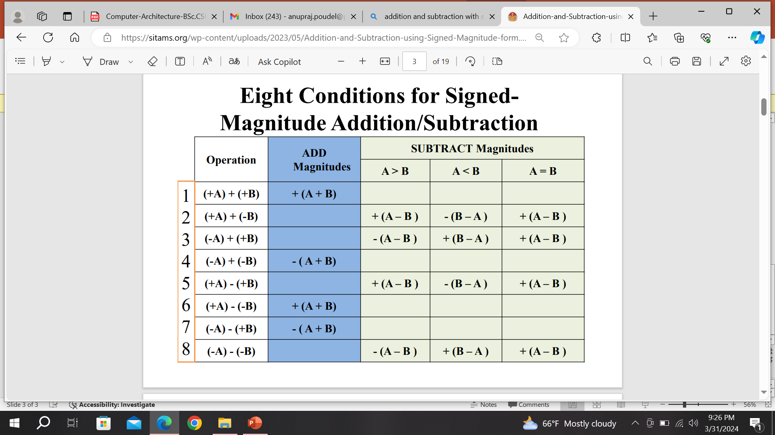

Slide 4
Addition and Subtraction with Signed magnitude data
ALGORITHM:
When the sign of A and B are identical, add the two magnitudes and attach the sign of A to the result.
When the sign of A and B are different, compare the magnitudes, subtract smaller number from the larger.
Choose the sign of the result to be same as A if A>B or complement the sign of A if A<B.
If the two magnitudes are equal, subtract B from A and Make the sign of the result positive.

Slide 5
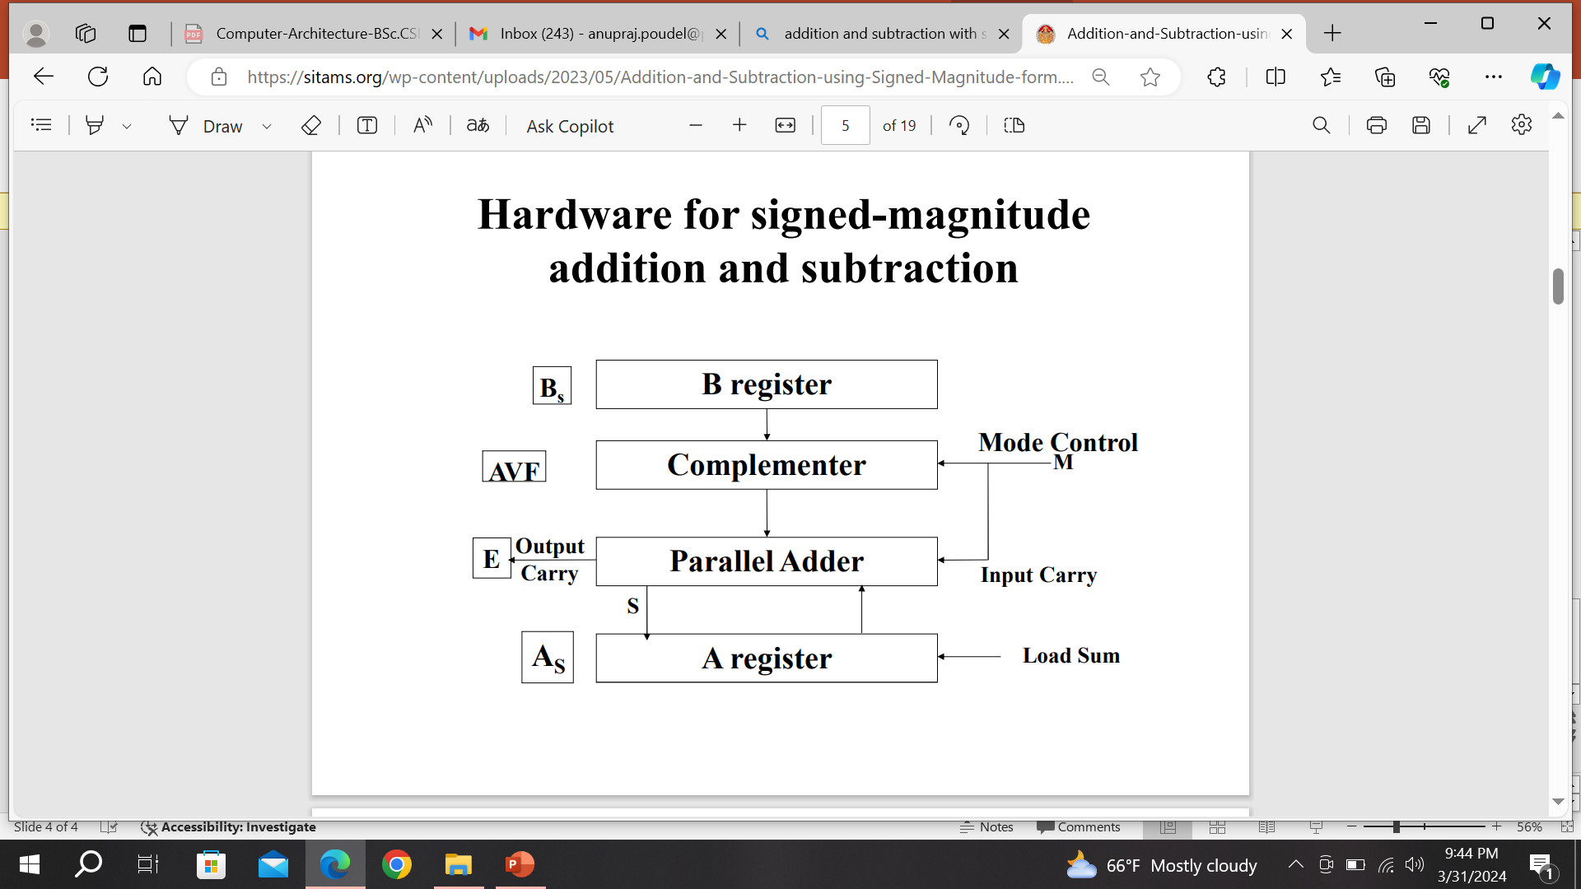

Slide 6
The block diagram consist of register A and B and the sign flipflops As and Bs. Subtraction is done by adding A to the 2’s complement of B.
The o/p carry is transferred to E. The add overflow flipflop(AVF) holds the overflow bit when A and B are added.
The addition A+B is done through the parallel adder and the sum is transferred to A register.
When the Mode bit M=0 the o/p of B is transferred to the adder, the i/p carry is 0 and the o/p of the adder is equal to sum A+B
When M=1, the 1’s complement of B is applied to adder, the i/p carry is 1 and the o/p is equal to A+ B’+1.

Slide 7
addition and subtraction with signed 2's complement of data
Addition:
In 2’s complement, we perform addition the same as an addition for unsigned binary numbers. The only difference is here we discard the out carry i.e carry from MSB bit as long as the range lies within the accepted range for 2’s complement representation.

Slide 8
x=2, y=3
addition: 0010
0011
0101
---> +5 in 4 bits
x=-2,y=-3
addition: 1110
1101
1011
---> -5 in 4 bits
(discarding the out carry 1)

Slide 9
Subtraction
Consider if we have to find the subtraction x-y, we perform the following steps:
Take 2’s complement of y
Add x and 2’s complement of y
Example
x=3, y=2 for 4 bits 2's complement representation
3---> 0011
Take 2's complement of 2----> 0010
1101 + 1 ---> 1110
Adding 0011 and 1110
0011
1110
0001
---> +1 (discard carry 1 from MSB)

Slide 10
Multiplication Algorithms
Booth's Algorithm
Booth's algorithm is used for multiplying binary numbers. It reduces the number of addition operations required, making it efficient for signed number multiplication.
Steps:
Initialize Variables:
A (Accumulator) = 0
Q (Multiplier) = Binary form of the multiplier
M (Multiplicand) = Binary form of the multiplicand
Q-1 = 0 (Extra bit to handle intermediate operations)
Set the counter equal to the number of bits in the multiplier.
M (Multiplicand) = 0101
-M = 2's complement of M = 1011
Q (Multiplier) = 1101
A (Accumulator) = 0000
Q-1 = 0
Number of bits = 4
We'll use 5 (which is 0101 in binary) and −3 (which is 1101 in binary using 2's complement).

Slide 11
Booth's Recoding:
Booth's algorithm examines pairs of bits (Qₙ, Qₙ₋₁) to determine the operation:
If (Q₀, Q₋₁) = (0, 0) or (1, 1): No operation (Just arithmetic shift right)
If (Q₀, Q₋₁) = (1, 0): Subtract M from A and perform an arithmetic shift right.
If (Q₀, Q₋₁) = (0, 1): Add M to A and perform an arithmetic shift right.

Slide 12
Perform the Operations:
Depending on the pairs of bits, adjust A accordingly (either add, subtract, or do nothing).
Shift A and Q to the right.
Decrement the counter and repeat the process until the counter reaches zero.
Final Result:
The final product will be in the combination of A and Q.
This algorithm efficiently reduces the number of required operations for multiplication, especially when there are consecutive 1s in the binary representation of the numbers.

Slide 13
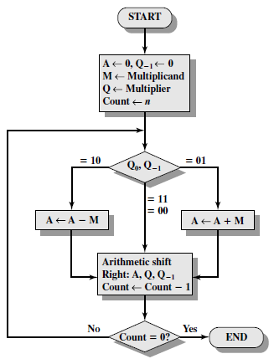
Example:
Multiply -7 x 3

Slide 14
Division Algorithm
Division algorithm in computer architecture is of two categories.
The first one is Slow Division. In the slow division, we get one digit of the quotient every iteration. The algorithms for slow division category are Restoring, Non-Performing Restoring, Non-Restoring, and SRT.
The second category is the Fast Division. In this method, the quotient is predicted to the closest approximation to the actual quotient, and then the calculation starts. The algorithms for fast division category are Newton–Raphson, and Goldschmidt.

Slide 15
Restoring Algorithm
The restoring division algorithm is a slow division algorithm that calculates the quotient digit by digit. This algorithm will generate a quotient and a remainder after the division algorithm.
Division algorithm in computer architecture uses registers for storing the numbers and calculations. The division works with the assumption that the dividend is greater than the divisor.
This division algorithm in computer architecture uses three registers. Register A is initialized to 0, register Q stores the dividend, and register M stores the divisor. N is used as a counter and stores the number of bits present in the dividend.

Slide 16
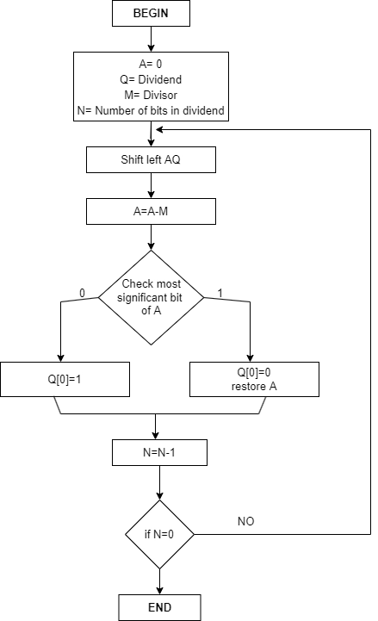
We initialize the variables. Register A is initialized with 0, register Q will have the dividend, and register M will contain the divisor. N is the counter and has a value equal to the number of bits present in the dividend.
The value of AQ(here in this step, A and Q will be treated as a single unit) will shift to the left.
In this step, subtraction occurs. M will be subtracted from A, and A will store the result.
In this step, we check for the most significant bit of A. Suppose the most significant bit in A is 1 after the above three stages in the restoring division algorithm in computer architecture. In that case, it will set the least significant bit of Q as 0, and the value of A will again become what it was before the subtraction operation in step 3. If the most significant bit in A is 0, then it will set the LSB of Q as 1.
5. N is decreased by 1 in this step.
6. In this step, we check the value of N. If the value of N becomes 0, we break the loop here or move back to step 2.
7. In this step, we have our answer with the quotient in Q and the remainder in A.

Slide 17
Let the dividend be 0111(7) and the divisor 0011(3).
N | M | A | Q | Operation
4 | 0011 | 0000 | 0111 | Initialization
 |  | 0000 | 111_ | SHL AQ
 |  | 1101 | 111_ | A= A-M
 |  | 0000 | 1110 | Q[0]=0 and restore A
3 | 0011 | 0001 | 1100 | SHL AQ
 | 0011 | 1110 | 110_ | A=A-M
 | 0011 | 0001 | 1100 | Q[0]=0 and restore A
2 | 0011 | 0011 | 100_ | SHL AQ
 | 0011 | 0000 | 100_ | A=A-M
 | 0011 | 0000 | 1001 | Q[0]=1
1 | 0011 | 0001 | 001_ | SHL AQ
 | 0011 | 1110 | 001_ | A=A-M
 | 0011 | 0001 | 0010 | Q[0]= 0 and restore A
We got the quotient as 0010, which is 2, and the remainder as 0001, which is 1.

Slide 18
Non-Restoring Division Algorithm for Unsigned Integer
Instead of the quotient digit set {0, 1}, the set {-1, 1} is used by the non-restoring division. The non-restoring division algorithm is more complex as compared to the restoring division algorithm.
But when we implement this algorithm in hardware, it has an advantage, i.e., it contains only one decision and addition/subtraction per quotient bit.
After performing the subtraction operation, there will not be any restoring steps. Due to this, the numbers of operations basically cut down up to half. Because of the less operation, the execution of this algorithm will be fast.
This algorithm basically performs simple operations such as addition, subtraction. In this method, we will use the sign bit of register A. 0 is the starting value/bit of register A.

Slide 19
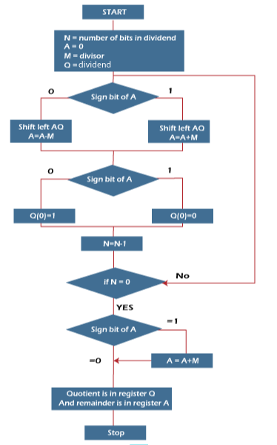
Step 1: In this step, the corresponding value will be initialized to the registers, i.e., register A will contain value 0, register M will contain Divisor, register Q will contain Dividend, and N is used to specify the number of bits in dividend.
Step 2: In this step, we will check the sign bit of A.
Step 3: If this bit of register A is 1, then shift the value of AQ through left, and perform A = A + M. If this bit is 0, then shift the value of AQ into left and perform A = A - M. That means in case of 0, the 2's complement of M is added into register A, and the result is stored into A.
Step 4: Now, we will check the sign bit of A again.
Step 5: If this bit of register A is 1, then Q[0] will become 0. If this bit is 0, then Q[0] will become 1. Here Q[0] indicates the least significant bit of Q.
Step 6: After that, the value of N will be decremented. Here N is used as a counter.
Step 7: If the value of N = 0, then we will go to the next step. Otherwise, we have to again go to step 2.
Step 8: We will perform A = A + M if the sign bit of register A is 1.
Step 9: This is the last step. In this step, register A contains the remainder, and register Q contains the quotient.

Slide 20
Dividend = 11
Divisor = 3
-M = 11101
N | M | A | Q | Action
4 | 00011 | 00000 | 1011 | Begin
 | 00011 | 00001 | 011_ | Shift left AQ
 | 00011 | 11110 | 011_ | A = A - M
3 | 00011 | 11110 | 0110 | Q[0] = 0
 | 00011 | 11100 | 110_ | Shift left AQ
 | 00011 | 11111 | 110_ | A = A + M
2 | 00011 | 11111 | 1100 | Q[0] = 0
 | 00011 | 11111 | 100_ | Shift left AQ
 | 00011 | 00010 | 100_ | A = A +M
1 | 00011 | 00010 | 1001 | Q[0] = 1
 | 00011 | 00101 | 001_ | Shift left AQ
 | 00011 | 00010 | 001_ | A = A - M
0 | 00011 | 00010 | 0011 | Q[0] = 1
So, register A contains the remainder 2, and register Q contains the quotient 3.

